Slide 1

Introduction to Computer Obstacle task
Professor : Jake Tarn
Lecturer: Sunny

Slide 2
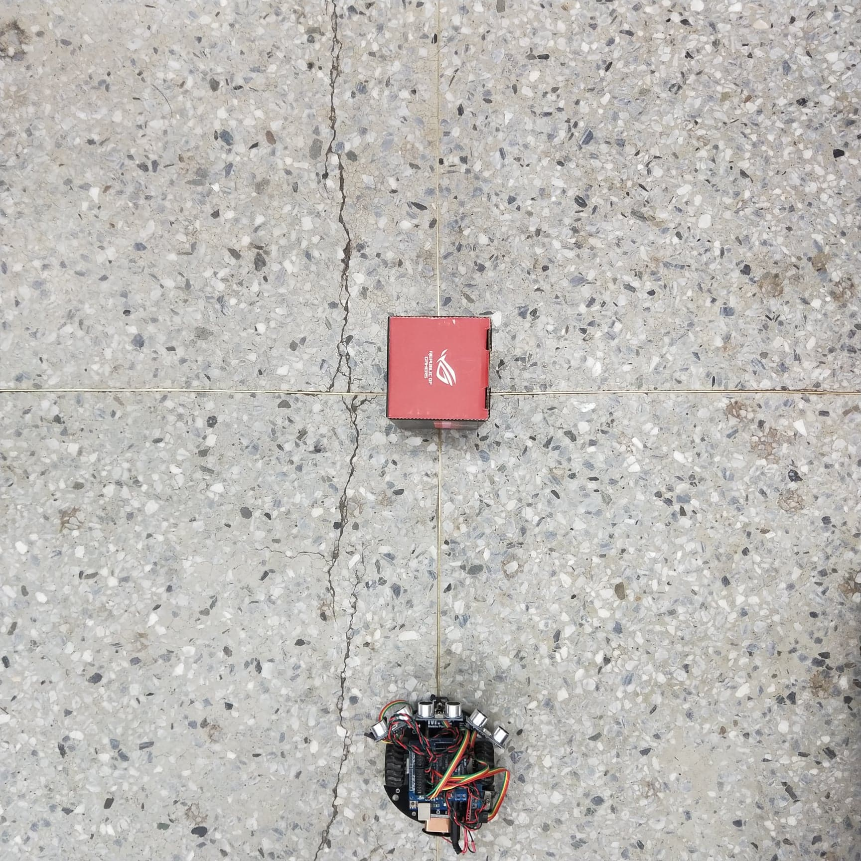

Slide 3
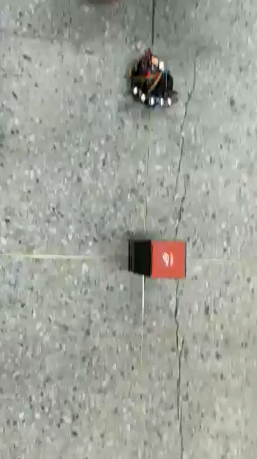

Slide 4
V_{L}
V
V_{R}
ω
r
s

Slide 5
Tricycle Model
V = rω
V_{L}= (r+s) ω
V_{R}= (r-s) ω

Slide 6
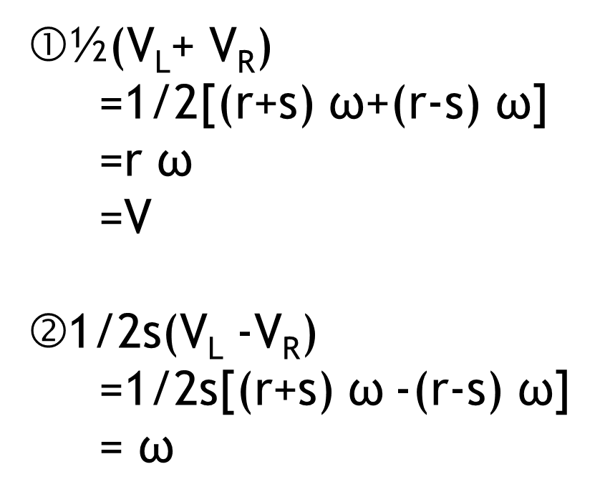

½(V_{L}+ V_{R})
=1/2[(r+s) $\text{ω}$+(r-s) $\text{ω}$]
=r $\text{ω}$
=V
1/2s(V_{L} -V_{R})
=1/2s[(r+s) $\text{ω}$-(r-s) $\text{ω}$]
= $\text{ω}$
$$\left[\begin{matrix}V \\ \text{ω}\end{matrix}\right]=\left[\begin{matrix}1/2 & 1/2 \\ 1/2S & −1/2S\end{matrix}\right]\left[\begin{matrix}\text{V}\text{L} \\ \text{V}\text{R}\end{matrix}\right]$$

